Slide 1


Chapter 3
Transport Layer
전송계층
Computer Networking: A Top Down Approach
7th Edition, Global Edition
Jim Kurose, Keith Ross
Pearson
April 2016
Transport Layer
2-<number>

Slide 2
Chapter 3: Transport Layer
our goals:
understand principles behind transport layer services:
  multiplexing, demultiplexing
  reliable data transfer
  flow control
  congestion control
learn about Internet transport layer protocols:
  UDP: connectionless transport
  TCP: connection-oriented reliable transport
  TCP congestion control
Transport Layer
3-<number>

Slide 3
Chapter 3 outline
3.5 connection-oriented transport: TCP
  segment structure
  reliable data transfer
  flow control
  connection management
3.6 principles of congestion control
3.7 TCP congestion control
Transport Layer
3-<number>

Slide 4
TCP: Overview RFCs: 793,1122,1323, 2018, 2581
point-to-point:
  one sender, one receiver
reliable, in-order byte steam:
  no “message boundaries”
pipelined:
  TCP congestion and flow control set window size
  혼잡과 흐름 제어를 위해 윈도우 사이즈 결정
full duplex data:
  bi-directional data flow in same connection
  MSS: maximum segment size
connection-oriented:
  handshaking (exchange of control msgs) inits sender, receiver state before data exchange
flow controlled:
  sender will not overwhelm receiver
Transport Layer
3-<number>

Slide 5
TCP segment structure
32 bits
URG: urgent data
(generally not used)
counting
by bytes
of data
(not segments!)
source port #
dest port #
sequence number
ACK: ACK #
valid
acknowledgement number
head
len
not
used
U
receive window
A
PSH: push data now
(generally not used)
P
R
S
F
# bytes
rcvr willing
to accept
checksum
Urg data pointer
RST, SYN, FIN:
connection estab
(setup, teardown
commands)
options (variable length)
application
data
(variable length)
Internet
checksum
(as in UDP)
Transport Layer
3-<number>

Slide 6
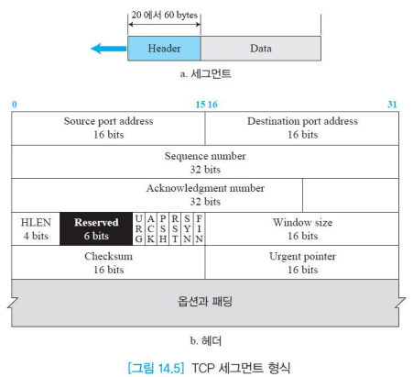
TCP 세그먼트 형식

Slide 7
TCP 세그먼트 형식
  발신지 포트 번호(source port address)
  목적지 포트 번호(destination port address)
  순서 번호(sequence number)
  확인응답 번호(acknowledgement number)
  헤더 길이(header length) : 4 바이트 워드 값
  제어(control) : 제어 또는 플래그
  예약(reserved)
  창 크기(window size)
  검사합(checksum)
  긴급 포인터(urgent pointer)
  옵션(option)

Slide 8
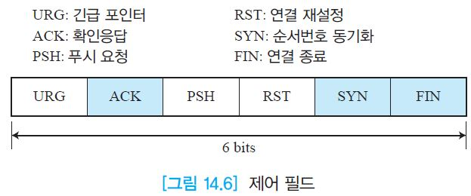
제어 필드
추가 제어 비트
  ECE (Explicit Congestion notification Echo)
  IP 헤더의 ECN와 연동 혼잡 제어을 위해 사용
  CWR (Congestion Window Reduced)
  ECE를 확인하여 윈도우 크기를 줄임. ECE를 중복적으로 보내지 않아도 됨

Slide 9
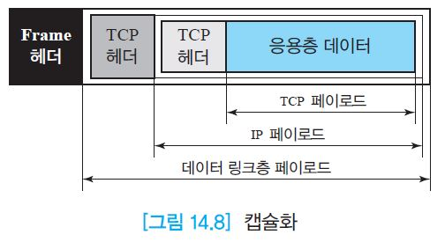
캡슐화

Slide 10
TCP seq. numbers, ACKs
outgoing segment from sender
sequence numbers:
  byte stream “number” of first byte in segment’s data
  보내질 응용계층 데이터의 첫 바이트 주소
acknowledgements:
  seq # of next segment to get
  다음 받고자 하는 순차 번호
  cumulative ACK
Q: how receiver handles out-of-order segments?
source port #
dest port #
sequence number
acknowledgement number
rwnd
checksum
urg pointer
window size
N
  sender sequence number space
sent
ACKed
sent, not-yet ACKed
(“in-flight”)
usable
but not
yet sent
not
usable
incoming segment to sender
source port #
dest port #
sequence number
acknowledgement number
A
rwnd
checksum
urg pointer
Transport Layer
3-<number>

Slide 11

TCP seq. numbers, ACKs
Host A
Host B
User
types
‘C’
Seq=42, ACK=79, data = ‘C’
host ACKs
receipt of
‘C’, echoes
back ‘C’
Seq=79, ACK=43, data = ‘C’
host ACKs
receipt
of echoed
‘C’
Seq=43, ACK=80
simple telnet scenario
Transport Layer
3-<number>

Slide 12
TCP 타이머 시간의 결정?
Q: how to set TCP timeout value?
longer than RTT
  RTT은 변한다
too short: premature timeout, unnecessary retransmissions
너무 짧으면 : 많은 재전송
too long: slow reaction to segment loss
너무 길면 : 손실에 대한 대처
문제
Q: how to estimate RTT?
SampleRTT: measured time from segment transmission until ACK receipt
  ignore retransmissions
SampleRTT will vary, want estimated RTT “smoother”
  average several recent measurements, not just current SampleRTT
Transport Layer
3-<number>

Slide 13

TCP round trip time, timeout
EstimatedRTT = (1- α)*EstimatedRTT + α*SampleRTT
exponential weighted moving average
influence of past sample decreases exponentially fast
typical value: α = 0.125
RTT: gaia.cs.umass.edu to fantasia.eurecom.fr
RTT (milliseconds)
sampleRTT
EstimatedRTT
time (seconds)
Transport Layer
3-<number>

Slide 14

TCP round trip time, timeout
timeout interval: EstimatedRTT plus “safety margin”
  large variation in EstimatedRTT -> larger safety margin
estimate SampleRTT deviation from EstimatedRTT:
DevRTT = (1-β)*DevRTT +
β*|SampleRTT-EstimatedRTT|
(typically, β = 0.25)
TimeoutInterval = EstimatedRTT + 4*DevRTT
estimated RTT
“safety margin”
* Check out the online interactive exercises for more examples: http://gaia.cs.umass.edu/kurose_ross/interactive/
Transport Layer
3-<number>

Slide 15
Chapter 3 outline
3.1 transport-layer services
3.2 multiplexing and demultiplexing
3.3 connectionless transport: UDP
3.4 principles of reliable data transfer
3.5 connection-oriented transport: TCP
  segment structure
  reliable data transfer
  flow control
  connection management
3.6 principles of congestion control
3.7 TCP congestion control
Transport Layer
3-<number>

Slide 16
TCP reliable data transfer
TCP creates 신뢰성 service on top of IP’s unreliable service
  pipelined segments
  cumulative acks
  single retransmission timer
retransmissions 재전송 triggered by:
  timeout events
  duplicate acks
Transport Layer
3-<number>

Slide 17
TCP sender events:
data rcvd from app:
create segment with seq #
seq # is byte-stream number of first data byte in segment
start timer if not already running
  think of timer as for oldest unacked segment
  expiration interval: TimeOutInterval
timeout:
retransmit segment that caused timeout
restart timer
ack rcvd:
if ack acknowledges previously unacked segments
  update what is known to be ACKed
  start timer if there are still unacked segments
Transport Layer
3-<number>

Slide 18
TCP의 신뢰성 있는 전송 방법
송신자는 응용층의 데이터를 받으면
  세그먼트를 만들면서 시퀀스 번호 부여
  보낸 후에 타이머를 설정
타이머가 종료되면
  재전송 및 타이머 설정
Ack를 받으면
  윈도우에 ack번호 재설정
  Ack를 받지 않은 세그먼트들이 윈도우 있다면 timer 시작함
수신자가 송신자로부터 데이터를 받으면
  비트 에러 체크 (checksum)
  에러이면 NAK 재전송 요구
  시퀀스 번호를 검사하여 문제가 없으면 누적 ack를 보냄
  만약 패킷이 중복되면 버림
실제 TCP에서는 GBN과 Selective 방식의 절충 방식을 사용
TCP의 작동 원리는 계속 진화함
(네트워크의 주요 연구 주제)
Transport Layer
3-<number>

Slide 19
TCP: retransmission scenarios
Host A
Host B
Host A
Host B
SendBase=92
Seq=92, 8 bytes of data
Seq=92, 8 bytes of data
timeout
timeout
Seq=100, 20 bytes of data
ACK=100
X
ACK=100
ACK=120
Seq=92, 8 bytes of data
Seq=92, 8
bytes of data
SendBase=100
SendBase=120
ACK=100
ACK=120
SendBase=120
lost ACK scenario
premature timeout
짧은 타이머의 문제
Transport Layer
3-<number>

Slide 20
TCP: retransmission scenarios
Host A
Host B
타이머의 시간 설정이 적당한 경우에는
  호스트 B가 1번째 ack 전송이 실패해도 2번째 ack를 A가 받았기에 A는 1,2번 모두 잘 받은 것으로 판단함
  이것이 누적 ACK의 장점이다.
Seq=92, 8 bytes of data
Seq=100, 20 bytes of data
timeout
ACK=100
X
ACK=120
Seq=120, 15 bytes of data
cumulative ACK
Transport Layer
3-<number>

Slide 21
TCP ACK generation [RFC 1122, RFC 2581]
event at receiver
arrival of in-order segment with
expected seq #. All data up to
expected seq # already ACKed
arrival of in-order segment with
expected seq #. One other
segment has ACK pending
arrival of out-of-order segment
higher-than-expect seq. # .
Gap detected
arrival of segment that
partially or completely fills gap
TCP receiver action
delayed ACK. Wait up to 500ms
for next segment. If no next segment,
send ACK
immediately send single cumulative
ACK, ACKing both in-order segments
immediately send duplicate ACK,
indicating seq. # of next expected byte
immediate send ACK, provided that
segment starts at lower end of gap
Transport Layer
3-<number>

Slide 22
TCP fast retransmit
time-out period often relatively long:
  long delay before resending lost packet
detect lost segments via duplicate ACKs.
  sender often sends many segments back-to-back
  if segment is lost, there will likely be many duplicate ACKs.
TCP fast retransmit
if sender receives 3 ACKs for same data
(“triple duplicate ACKs”),
resend unacked segment with smallest seq #
  likely that unacked segment lost, so don’t wait for timeout
(“triple duplicate ACKs”),
Transport Layer
3-<number>

Slide 23
TCP fast retransmit (GBN)
Host A
Host B
만약 세번의 중복 ACK가 도달하면 Timeout이 안되었더라도 재송한다.
➔
빠른 재전송
TCP의 재 전송은
  Timeout 경우
  3개 이상의 중복 ack를 받았을 때
Seq=92, 8 bytes of data
Seq=100, 20 bytes of data
X
ACK=100
timeout
ACK=100
ACK=100
ACK=100
Seq=100, 20 bytes of data
fast retransmit after sender
receipt of triple duplicate ACK
Transport Layer
3-<number>

Slide 24
Chapter 3 outline
3.1 transport-layer services
3.2 multiplexing and demultiplexing
3.3 connectionless transport: UDP
3.4 principles of reliable data transfer
3.5 connection-oriented transport: TCP
  segment structure
  reliable data transfer
  flow control
  connection management
3.6 principles of congestion control
3.7 TCP congestion control
Transport Layer
3-<number>

Slide 25
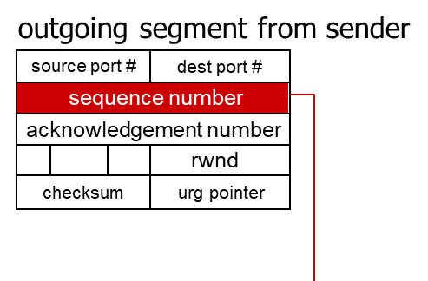
TCP flow control
application
process
application may
remove data from
TCP socket buffers ….
application
TCP socket
receiver buffers
OS
… slower than TCP
receiver is delivering
(sender is sending)
TCP
code
flow control
IP
code
receiver controls sender, so sender won’t overflow receiver’s buffer by transmitting too much, too fast
from sender
receiver protocol stack
Transport Layer
3-<number>

Slide 26
TCP flow control
outgoing segment from sender
source port #
dest port #
sequence number
acknowledgement number
rwnd
receiver “advertises” free buffer space by including rwnd value in TCP header of receiver-to-sender segments
  RcvBuffer size set via socket options (typical default is 4096 bytes)
  many OS autoadjust (재조정) RcvBuffer
sender limits amount of unacked (“in-flight”) data to receiver’s rwnd value
guarantees receive buffer will not overflow
checksum
urg pointer
to application process
RcvBuffer
buffered data
rwnd
free buffer space
TCP segment payloads
receiver-side buffering
Transport Layer
3-<number>

Slide 27
TCP flow control
outgoing segment from sender
source port #
dest port #
sequence number
acknowledgement number
rwnd
수신자는 받을 수 있는 버퍼 사이즈 값을 패킷 헤드에 넣어 송신자에 보낸다.
  RcvBuffer : 버퍼 사이즈는 소켓의 옵션으로 기본은 4096바이트,
  OS에서 필요시 자동적으로 재조정
송신자는 보내고 아직 ack를 받지 않은 패킷의 수를 수신자의 rwnd값보다 작게
이렇게 해서 수신자의 버퍼의 오버플로우를 방지
checksum
urg pointer
to application process
RcvBuffer
buffered data
rwnd
free buffer space
TCP segment payloads
receiver-side buffering
Transport Layer
3-<number>

Slide 28
Chapter 3 outline
3.5 connection-oriented transport: TCP
  segment structure
  reliable data transfer
  flow control
  connection management
  (연결 관리)
3.6 principles of congestion control
3.7 TCP congestion control
Transport Layer
3-<number>

Slide 29
Connection Management (연결 설정 관리)
before exchanging data, sender/receiver “handshake”:
agree to establish connection (each knowing the other willing to establish connection)
agree on connection parameters
application
application
connection state: ESTAB
connection variables:
  seq # client-to-server
  server-to-client
  rcvBuffer size
  at server,client
connection state: ESTAB
connection Variables:
  seq # client-to-server
  server-to-client
  rcvBuffer size
  at server,client
network
network
Socket clientSocket =
newSocket("hostname","port number");
Socket connectionSocket = welcomeSocket.accept();
Transport Layer
3-<number>

Slide 30
TCP 연결 설정
  3-방향 핸드 쉐이크(three-way handshake)
  클라이언트와 서버 응용 프로그램간 연결
  서버부터 시작(수동 개방(passive open))
  클라이언트부터 시작(능동 개방(active open))
    클라이언트는 SYN 플래그가 1로 설정된 SYN 세그먼트 전송
    서버는 SYN와 ACK 플래그가 1로 설정된 세그먼트 전송
    단순한 ACK 세그먼트 전송
  동시 개방
  SYN 플러딩 공격문제 (보안)

Slide 31



Agreeing to establish a connection
2-way handshake:
Q: will 2-way handshake always work in network?
variable delays
retransmitted messages (e.g. req_conn(x)) due to message loss
message reordering
can’t “see” other side
Let’s talk
ESTAB
OK
ESTAB
choose x
req_conn(x)
ESTAB
acc_conn(x)
ESTAB
Transport Layer
3-<number>
Notes:
Q: 과제 <중요>

Slide 32
Agreeing to establish a connection (무시)
2-way handshake failure scenarios:
choose x
choose x
req_conn(x)
req_conn(x)
ESTAB
ESTAB
retransmit
req_conn(x)
acc_conn(x)
retransmit
req_conn(x)
acc_conn(x)
ESTAB
ESTAB
data(x+1)
accept
data(x+1)
req_conn(x)
retransmit
data(x+1)
connection
x completes
connection
x completes
client terminates
server
forgets x
client terminates
server
forgets x
req_conn(x)
ESTAB
data(x+1)
ESTAB
half open connection!
(no client!)
accept
data(x+1)
Transport Layer
3-<number>

Slide 33
TCP 3-way handshake
client state
server state
LISTEN
LISTEN
choose init seq num, x
send TCP SYN msg
SYNSENT
SYNbit=1, Seq=x
choose init seq num, y
send TCP SYNACK
msg, acking SYN
SYN RCVD
SYNbit=1, Seq=y
ACKbit=1; ACKnum=x+1
received SYNACK(x)
indicates server is live;
send ACK for SYNACK;
this segment may contain
client-to-server data
ESTAB
ACKbit=1, ACKnum=y+1
received ACK(y)
indicates client is live
ESTAB
Transport Layer
3-<number>

Slide 34
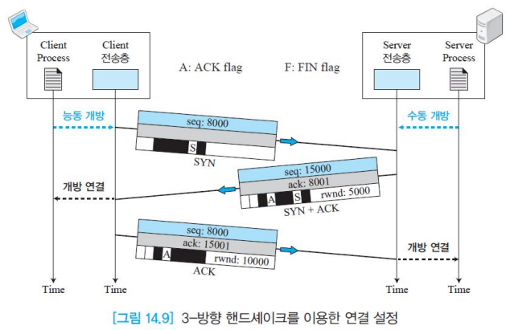

3-방향 핸드쉐이크(handshake) 연결
가상 회선 개설

Slide 35
TCP: closing a connection
client, server each close their side of connection
  send TCP segment with FIN bit = 1
respond to received FIN with ACK
  on receiving FIN, ACK can be combined with own FIN
simultaneous FIN exchanges can be handled
전송을 끝낼 때는 4-way 핸드세이킹
Transport Layer
3-<number>

Slide 36
절반 닫기
  한쪽에서는 데이터를 수신하면서 데이터 전송 종료 가능
  어느 쪽이든 요청 가능
  서버가 모든 데이터를 수신한 후에 처리를 시작하는 경우 발생(예:정렬(sort))

Slide 37
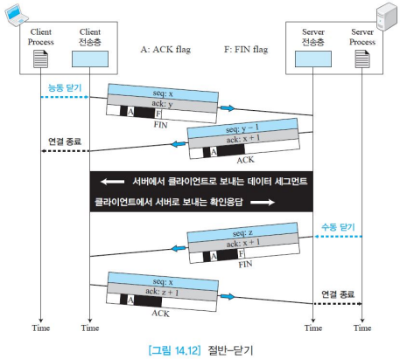
절반 닫기

Slide 38
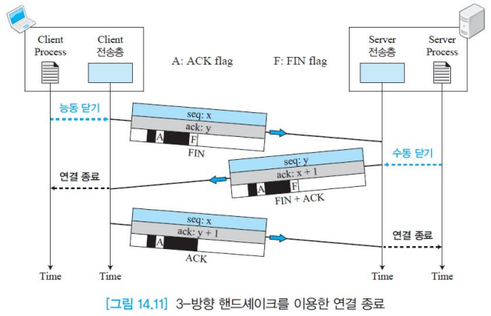
3-방향 핸드 쉐이크를 이용한 연결 종료

Slide 39
TCP: closing a connection
client state
server state
ESTAB
ESTAB
clientSocket.close()
FIN_WAIT_1
can no longer
send but can
receive data
FINbit=1, seq=x
CLOSE_WAIT
ACKbit=1; ACKnum=x+1
can still
send data
FIN_WAIT_2
wait for server
close
LAST_ACK
FINbit=1, seq=y
TIMED_WAIT
can no longer
send data
ACKbit=1; ACKnum=y+1
timed wait
for 2*max
segment lifetime
CLOSED
CLOSED
Transport Layer
3-<number>

Slide 40
TCP 통신 seq#, acq# 요약
Transport Layer
3-<number>

Slide 41
TCP 핸드 세이킹 (연결 설정)
1) 클라이언트(C) : 먼저 flag : syn 1로 셋팅
시퀀스 번호 = 임의, ack# =0
2) 서버(S) : flag : syn와 ack 1로 세팅
시퀀스 번호 = 임의,
ack# = C의 syn# + 1
3) 클라이언트는 ack를 1로 셋팅
시퀀스번호 = S의 ack#
ack# = S의 시퀀스# +1
Transport Layer
3-<number>

Slide 42
예) 핸드 세이킹 예
C -----------→ S syn :1
S # : 1000 A # : 0
←---------------
S# : 2000 A# : 1001
---------------→
S# : 1001 A# : 2001
Transport Layer
3-<number>

Slide 43
C/S가 양방향 데이터를 주고 받을 때 번호
클라이언트와 서버가 연결이 설정된 이후
C가 맨 처음 데이터를 보낼 때는 설정 때 사용했던 seq#와 ack#번호 그대로 사용
그 이후부터는
받은 쪽에서 상대방에게 데이터를 보낼 때
seq# = 받은 ack# 그대로
ack# = 받은 seq# + (받을) Data크기

Slide 44
TCP data 전송
C 는 S에서 100 바이트씩 보내고
S는 C에서 500 바이트씩 보낼 때
C -------→ S psh + ack : 1로 세팅
Seq# : 1001 Ack#: 2001
C ←-------- S ack : 1로 세팅
Seq# : 2001 Ack# : 1101
C ----------→ S psh + ack : 1로 세팅
Seq# : 1101 Ack# : 2501
Transport Layer
3-<number>

Slide 45
데이터 전송
  양방향 데이터 전송
  데이터와 확인응답을 동시에 전송(piggyback)
  푸싱(pushing) 데이터
    푸시 비트를 설정하여 푸시 동작 요구
    창이 다 찰 때까지 기다리지 않는다는 것
  긴급 데이터 (어떤 경우?)
    URG 비트를 1로 설정, 긴급을 알림

Slide 46
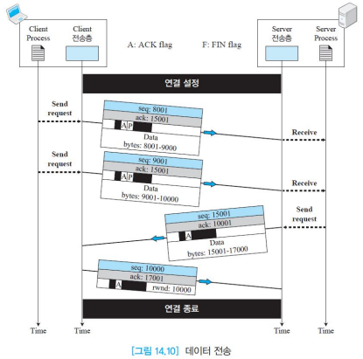
데이터 전송

Slide 47
Chapter 3 outline
3.1 transport-layer services
3.2 multiplexing and demultiplexing
3.3 connectionless transport: UDP
3.4 principles of reliable data transfer
3.5 connection-oriented transport: TCP
  segment structure
  reliable data transfer
  flow control
  connection management
3.6 principles of congestion control
3.7 TCP congestion control
Transport Layer
3-<number>

